Slide 1
Machine learning 101 Tips on Neural networks
Han Xiao
hxiao29@wisc.edu
CEE department

Slide 2
Objective
Code a neural network structure with keras
Can analyze the outcomes of neural networks
Apply different strategies to reduce errors with neural network simulations

Slide 3



Neural networks
How to calculate gradients in neural networks?
Chain rule
Input
Layer 1
Layer 2
Layer L
……
$${\hat{y}}_{1}$$
……
$${\hat{y}}_{2}$$
……
……
……
……
……
……
$${\hat{y}}_{n}$$
Input Layer
Output Layer
Error E
MSE, cross-entropy…
Hidden Layers

Slide 4
Neural networks
How to build neural networks?
Step 1: decide the structure of your network (depth, the number of neurons in each layer…)
Step 2: decide your activation function
Step 3: initialize your w and b
Step 4: Train!
- Forward propagation
- Backpropagation
Step 5: Generalization

Slide 5



Keras
Easy extensible
User friendly

Slide 6
An example
Simulate a curve

Slide 7

Generalization
What’s the difference between training data and test data?

Slide 8








Generalization
A cat classifier
Training data
Test data
Train
A ‘Good’ classifier with 0 error in training
Our model
Our model
Cat
Not Cat!

Slide 9
Generalization
Unknown target function
f : X → Y
Final hypothesis
g ≈ f
Training examples
(x₁,y₁), (x₂,y₂),…, (x_{n},y_{n})
Algorithm
A
Learning from data, page 4
Hypothesis
H

Slide 10
Generalization
Where could we get errors?
Cannot find a feasible model!

Slide 11

Generalization
Too powerful!
Where could we get errors?
$$y=x$$

Slide 12

Generalization
Where could we get errors?
$$y=x^{2}$$
Too week!

Slide 13




Generalization
Why we can get errors from hypothesis sets?
Assume the TRUE model we finally want is
$$f\left(x\right)=Y−ε$$
Calculate the expected error
$$E{[\hat{f}\left(x\right)−f\left(x\right)]}^{2}=E{[\hat{f}\left(x\right)−Y−ε]}^{2}$$
$$0$$
$$=E{[\hat{f}\left(x\right)−Y]}^{2}+E{[ε]}^{2}+2E\left[ε\right]E[\hat{f}\left(x\right)−Y]$$
$$=E{[\hat{f}\left(x\right)−E\left[\hat{f}\left(x\right)\right]+E\left[\hat{f}\left(x\right)\right]−Y]}^{2}+Var(ε)$$
$$=E{[\hat{f}\left(x\right)−E\left[\hat{f}\left(x\right)\right]]}^{2}+{(E\left[\hat{f}\left(x\right)\right]−Y)}^{2}+Var(ε)$$
$$=Var(\hat{f}\left(x\right))+{(E\left[\hat{f}\left(x\right)\right]−Y)}^{2}+Var(ε)$$

Slide 14
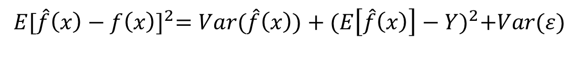
Generalization
$$E{[\hat{f}\left(x\right)−f\left(x\right)]}^{2}=Var(\hat{f}\left(x\right))+{(E\left[\hat{f}\left(x\right)\right]−Y)}^{2}+Var(ε)$$
Variance
Sensitivity to data
Bias
Irreducible error

Slide 15
Generalization
How to reduce errors?
If our model is too weak: easy!
If our model is too strong: overfitting problem
Early stopping
Regularizers!

Slide 16
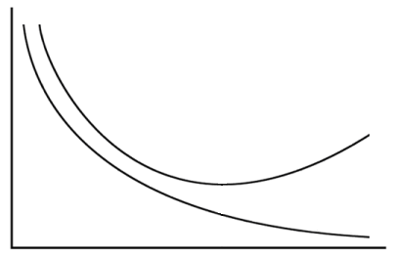
Early stop
Overfitting
Total
Loss
Stop at here
Testing set
Training set
Epochs
Notes:
Validation set: The data set can used to evaluate your model but not involve in training.
Validation set: seplit from training data
Acturally is difficult
http://deeplearning.net/tutorial/mlp.html#mlp

Slide 17

Regularizers
Idea: make our model ‘as smooth as possible’
If w too large → a small change of x will make a lot of difference!
$$y=wx+b$$
$$Error=MSE\left(or other error\right)+regularizer$$

Slide 18
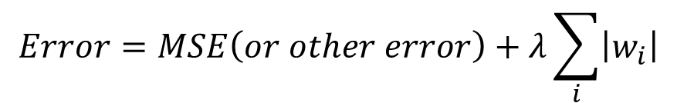
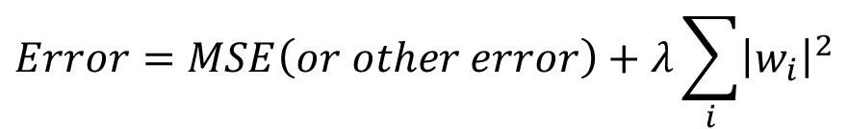
Regularizers
$$Error=MSE\left(or other error\right)+regularizer$$
L1 regularizer
L2 regularizer
$$Error=MSE\left(or other error\right)+λ\sum_{i}{\left|w_{i}\right|}$$
$$Error=MSE\left(or other error\right)+λ\sum_{i}{{\left|w_{i}\right|}^{2}}$$

Slide 19

Questions?
Topic of next lecture: tips on neural networks

